Slide 1

Motivation and Emotion
Chapter 9

Slide 2
Chapter 9 Learning Objective Menu
LO 9.1 Motivation
LO 9.2 Instinct approaches to motivation
LO 9.3 Drive-reduction approaches to motivation
LO 9.4 Three types of needs
LO 9.5 Arousal approaches to motivation
LO 9.6 Incentive approaches to motivation
LO 9.7 Maslow’s hierarchy of needs
LO 9.8 Self-determination theory of motivation
LO 9.9 Bodily causes of hunger
LO 9.10 Social factors influencing hunger
LO 9.11 Some problems in eating behavior
LO 9.12 Biological factors of obesity
LO 9.13 Three elements of emotion
LO 9.14 James-Lange theory of emotion
LO 9.15 Cannon-Bard theory of emotion
LO 9.16 Cognitive arousal theory of emotion
LO 9.17 Schacter and Singer’s classic study of emotion
LO 9.18 Facial feedback hypothesis
LO 9.19 Cognitive-mediational theory
LO 9.20 Positive psychology movement

Slide 3
Motivation
LO 9.1 Motivation
Motivation - the process by which activities are started, directed, and continued so that physical or psychological needs or wants are met.
Extrinsic motivation - type of motivation in which a person performs an action because it leads to an outcome that is separate from or external to the person.
Menu

Slide 4
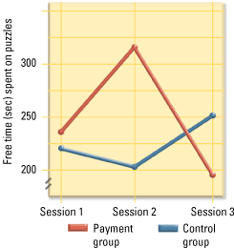
LO 9.1 Motivation
Menu

Slide 5
Instinct Approaches to Motivation
LO 9.2 Instinct approaches to motivation
Instincts - the biologically determined and innate patterns of behavior that exist in both people and animals.
Instinct approach - approach to motivation that assumes people are governed by instincts similar to those of animals.
Menu

Slide 6
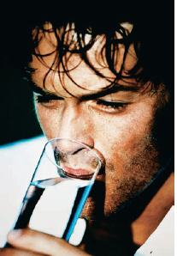

Drive Reduction Theory of Motivation
LO 9.3 Drive-reduction approaches to motivation
Need - a requirement of some material (such as food or water) that is essential for survival of the organism.
Drive - a psychological tension and physical arousal arising when there is a need that motivates the organism to act in order to fulfill the need and reduce the tension.
Drive-reduction theory - approach to motivation that assumes behavior arises from physiological needs that cause internal drives to push the organism to satisfy the need and reduce tension and arousal.
Menu

Slide 7
Drive Reduction Theory of Motivation
LO 9.3 Drive-reduction approaches to motivation
Primary drives - those drives that involve needs of the body such as hunger and thirst.
Acquired (secondary) drives - those drives that are learned through experience or conditioning, such as the need for money or social approval.
Homeostasis - the tendency of the body to maintain a steady state.
Menu

Slide 8


Three Types of Needs
LO 9.4 Three types of needs
Need for achievement (nAch) - a need that involves a strong desire to succeed in attaining goals, not only realistic ones but also challenging ones.
Need for affiliation (nAff) - the need for friendly social interactions and relationships with others.
Need for power (nPow) - the need to have control or influence over others.
Menu

Slide 9
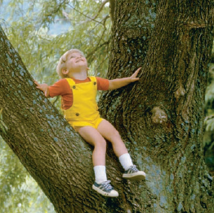
Arousal Approach to Motivation
LO 9.5 Arousal approaches to motivation
Stimulus motive - a motive that appears to be unlearned but causes an increase in stimulation, such as curiosity.
Arousal theory - theory of motivation in which people are said to have an optimal (best or ideal) level of tension that they seek to maintain by increasing or decreasing stimulation.
Menu

Slide 10
Arousal Approach to Motivation
LO 9.5 Arousal approaches to motivation
Yerkes-Dodson law - law stating performance is related to arousal; moderate levels of arousal lead to better performance than do levels of arousal that are too low or too high.
  This effect varies with the difficulty of the task: easy tasks require a high-moderate level while more difficult tasks require a low-moderate level.
Sensation seeker - someone who needs more arousal than the average person.
Menu

Slide 11
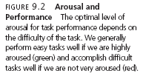
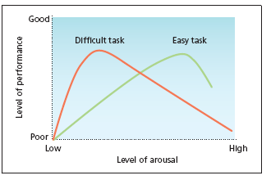
LO 9.5 Arousal approaches to motivation
Menu

Slide 12
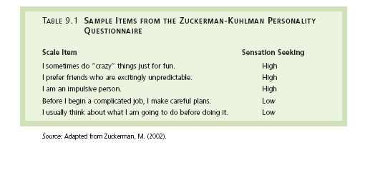
LO 9.5 Arousal approaches to motivation
Menu

Slide 13
Incentive Approaches to Motivation
LO 9.6 Incentive approaches to motivation
Incentives - things that attract or lure people into action.
Incentive approaches - theories of motivation in which behavior is explained as a response to the external stimulus and its rewarding properties.
Expectancy-value theories - incentive theories that assume the actions of humans cannot be predicted or fully understood without understanding the beliefs, values, and the importance that a person attaches to those beliefs and values at any given moment in time.
Menu

Slide 14
Maslow’s Hierarchy of Needs
LO 9.7 Maslow’s hierarchy of needs
Self-actualization - according to Maslow, the point that is seldom reached at which people have sufficiently satisfied the lower needs and achieved their full human potential.
Peak experiences- according to Maslow, times in a person’s life during which selfactualization is temporarily achieved.
Menu

Slide 15
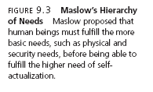
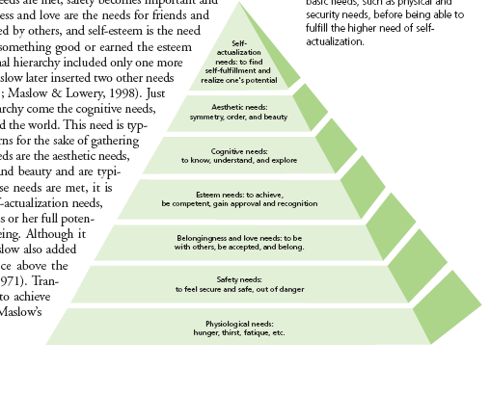
LO 9.7 Maslow’s hierarchy of needs
Menu

Slide 16
Self-Determination Theory of Motivation
LO 9.8 Self-determination theory of motivation
Self-determination theory (SDT) - theory of human motivation in which the social context of an action has an effect on the type of motivation existing for the action.
Intrinsic motivation - type of motivation in which a person performs an action because the act itself is rewarding or satisfying in some internal manner.
Menu

Slide 17
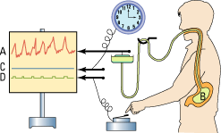
Hunger: Bodily Causes
LO 9.9 Bodily causes of hunger
Insulin - a hormone secreted by the pancreas to control the levels of fats, proteins, and carbohydrates in the body by reducing the level of glucose in the bloodstream.
Glucagons- hormones that are secreted by the pancreas to control the levels of fats, proteins, and carbohydrates in the body by increasing the level of glucose in the bloodstream.
Menu

Slide 18
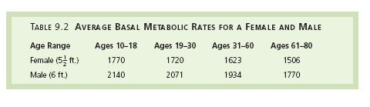
Hunger: Bodily Causes
LO 9.9 Bodily causes of hunger
Weight set point – the particular level of weight that the body tries to maintain.
Basal metabolic rate (BMR) - the rate at which the body burns energy when the organism is resting.
Menu

Slide 19

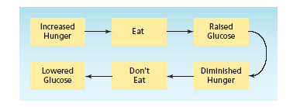
LO 9.9 Bodily causes of hunger
Menu

Slide 20


Hunger: Social Causes
LO 9.10 Social factors influencing hunger
Social cues for when meals are to be eaten.
Cultural customs.
Food preferences.
Use of food as a comfort device or escape from unpleasantness.
Some people may respond to the anticipation of eating by producing an insulin response, increasing the risk of obesity.
Menu

Slide 21
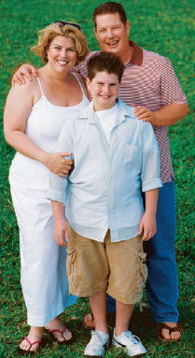
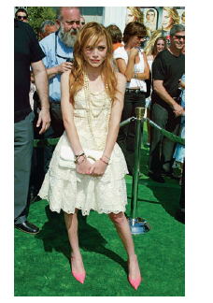
Eating Problems
LO 9.11 Some problems in eating behavior
Obesity - a condition in which the body weight of a person is 20 percent or more over the ideal body weight for that person’s height (actual percents vary across definitions).
Anorexia nervosa - a condition in which a person reduces eating to the point that a weight loss of 15 percent below the ideal body weight or more occurs.
Bulimia - a condition in which a person develops a cycle of “binging” or overeating enormous amounts of food at one sitting, and “purging” or deliberately vomiting after eating.
Menu

Slide 22
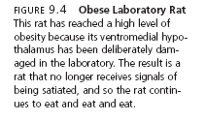
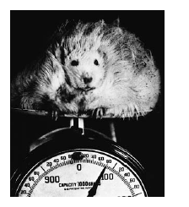
LO 9.11 Some problems in eating behavior
Menu

Slide 23
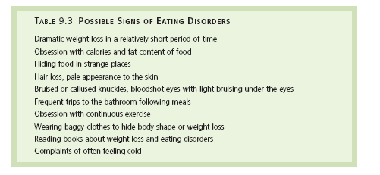
LO 9.11 Some problems in eating behavior
Menu

Slide 24
Biological Factors of Eating Problems
LO 9.12 Biological factors of obesity
Leptin - a hormone that, when released into the bloodstream, signals the hypothalamus that the body has had enough food and reduces the appetite while increasing the feeling of being full.
  Role of leptin in obesity.
  Genetics and obesity.
Genetics may play a part in anorexia and bulimia, as well as insensitivity to leptin.
Menu

Slide 25
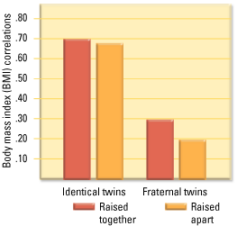
LO 9.12 Biological factors of obesity
98
Menu

Slide 26
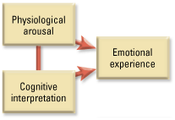
Elements of Emotion
LO 9.13 Three elements of emotion
Emotion - the “feeling” aspect of consciousness, characterized by a certain physical arousal, a certain behavior that reveals the emotion to the outside world, and an inner awareness of feelings.
Display rules - learned ways of controlling displays of emotion in social settings.
Menu

Slide 27

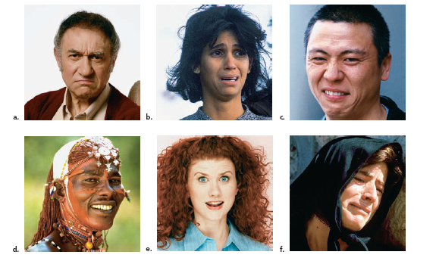
LO 9.13 Three elements of emotion
Menu

Slide 28
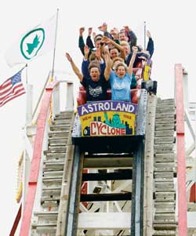

Common Sense Theory of Emotion
LO 9.13 Three elements of emotion
Common Sense Theory of Emotion - a stimulus leads to an emotion, which then leads to bodily arousal.
Menu

Slide 29
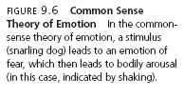
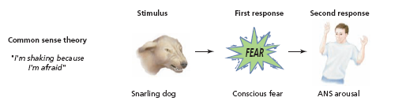
LO 9.13 Three elements of emotion
Menu

Slide 30
James-Lange Theory of Emotion
LO 9.14 James-Lange theory of emotion
James-Lange theory of emotion - theory in which a physiological reaction leads to the labeling of an emotion.
Menu

Slide 31

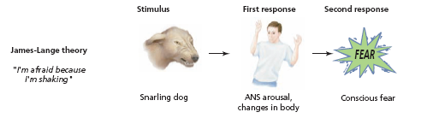
LO 9.14 James-Lange theory of emotion
Menu

Slide 32
Cannon-Bard Theory of Emotion
LO 9.15 Cannon-Bard theory of emotion
Cannon-Bard theory of emotion - theory in which the physiological reaction and the emotion are assumed to occur at the same time.
Menu

Slide 33

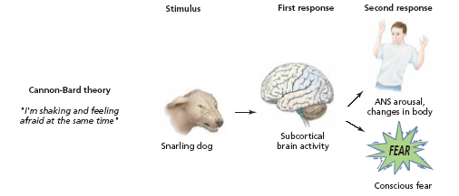
LO 9.15 Cannon-Bard theory of emotion
Menu

Slide 34
Cognitive Arousal Theory of Emotion
LO 9.16 Cognitive arousal theory of emotion
Cognitive arousal theory – theory of emotion in which both the physical arousal and the labeling of that arousal based on cues from the environment must occur before the emotion is experienced.
Menu

Slide 35
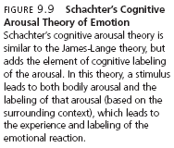
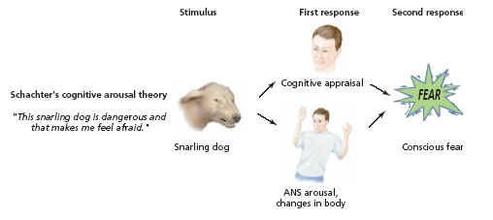
LO 9.16 Cognitive arousal theory of emotion
Menu

Slide 36
Schacter and Singer’s Study of Emotion
LO 9.17 Schacter and Singer’s classic study of emotion
Participants who were exposed to the “angry” man interpreted their physical arousal as anger
Participants who were exposed to the “happy” man interpreted their physical arousal as happiness.
Menu

Slide 37

Facial Feedback Hypothesis
LO 9.18 Facial feedback hypothesis
Facial feedback hypothesis - theory of emotion that assumes that facial expressions provide feedback to the brain concerning the emotion being expressed, which in turn causes and intensifies the emotion.
Menu

Slide 38
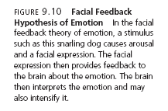

LO 9.18 Facial feedback hypothesis
Menu

Slide 39
Cognitive Mediational Theory
LO 9.19 Cognitive-mediational theory
Cognitive-mediational theory - theory of emotion in which a stimulus must be interpreted (appraised) by a person in order to result in a physical response and an emotional reaction.
Menu

Slide 40
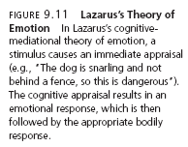

LO 9.19 Cognitive-mediational theory.
Menu

Slide 41
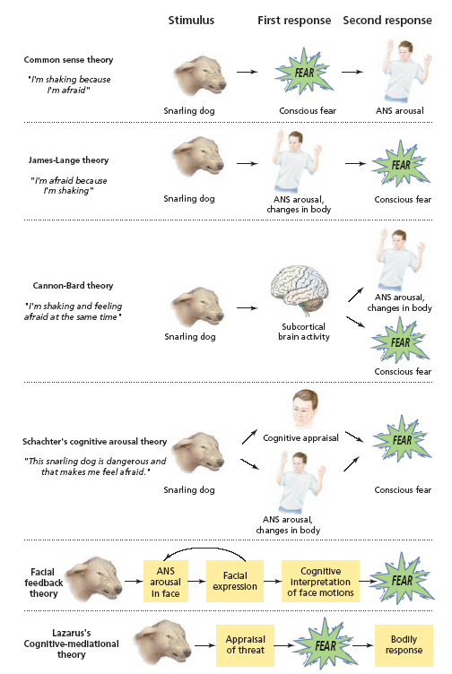
Menu

Slide 42
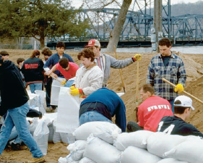
Positive Psychology Movement
LO 9.20 Positive psychology movement
Positive psychology movement - a viewpoint that recommends shifting the focus of psychology away from the negative aspects to a more positive focus on strengths, well-being, and the pursuit of happiness.
Menu

